Slide 1
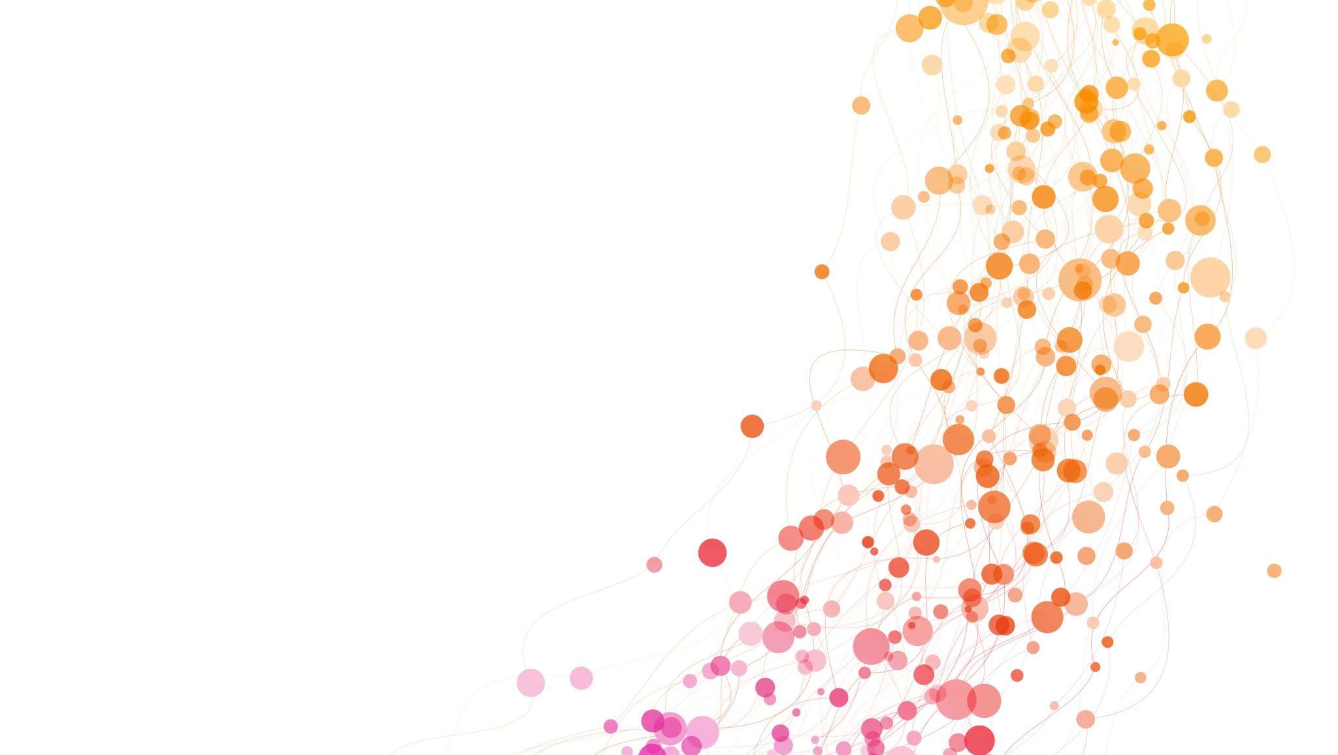
Prestressed Concrete
Lecture 2

Slide 2
Analysis of Prestress and Bending Stress Basic Assumptions
-The analysis of stresses developed in a prestressed concrete structural element is based on the following assumptions: (i) concrete is a homogeneous elastic material, (ii) within the range of working stresses, both concrete and steel behave elastically, except for the small amount of creep which occurs in both the materials under sustained loading, and, (iii) a plane section before bending is assumed to remain plane even after bending, which implies a linear strain distribution across the depth of the member. - If tensile stresses do not exceed the limit of modulus of rupture of concrete (corresponding to the stage of visible cracking of concrete), any change in the loading of the member results in a change of stress in the concrete only, the sole function of the prestressing tendon being to impart and maintain the prestress in the concrete.

Slide 3

Analysis of Prestress
The following notations and sign conventions are used for the analysis of
prestress:
P = Prestressing force (positive when producing direct compression)
e = Eccentricity of prestressing force
M = P. e = Moment
A = Cross-sectional area of the concrete member
I = Second moment of area of section about its centroid
Z_{t} and Z_{b} = Section modulus of the top and bottom fibers
f_{sup} and f_{inf} = Prestress in concrete developed at the top and bottom fibers
(Positive when compressive and negative when tensile in nature)
y_{t} and y_{b} = Distance of the top and bottom fibers from the centroid of the section
i = Radius of gyration

Slide 4
Concentric Tendons
Uniform prestress in concrete = P/A, which is compressive across the depth of the beam.

Slide 5
Eccentric Tendon

Slide 6
Resultant Stresses at a Section
The resultant stresses in concrete at any section are obtained by superposing the effect of prestress and the flexural stresses developed due to the loads. If Mq and Mg are the live load and dead-load moments at the central span section, then,

Slide 7
Examples
Examples: 1, 2, 3, 4, 5.

Slide 8
Example 1
A rectangular concrete beam 100 mm wide by 250 mm deep spanning over 8 m is prestressed by a straight cable carrying an effective prestressing force of 250 kN located at an eccentricity of 40 mm. The beam supports a live load of 1.2 kN/m,
(a) Calculate the resultant stress distribution for the center-of-span cross section
of the beam assuming the density of concrete as 24 kN/m³.
(b) Find the magnitude of the prestressing force with an eccentricity of 40 mm
which can balance the stresses due to dead and live loads at the soffit of the
center span section.

Slide 9
Example 1

Slide 10
Example 2
A rectangular concrete beam of cross-section 30 cm deep and 20 cm wide is prestressed by means of 15 wires of 5 mm diameter located 6.5 cm from the bottom of the beam and 3 wires of diameter of 5 mm, 2.5 cm from the top. Assuming the prestress in the steel as 840 N/mm², calculate the stresses at the extreme fibers of the mid-span section when the beam is supporting its own weight over a span of 6 m. If a uniformly distributed live load of 6 kN/m is imposed, evaluate the maximum working stress in concrete. The density of concrete is 24 kN/m³.

Slide 11
Example 2

Slide 12
Example 2

Slide 13
Example 3
An unsymmetrical I-section beam is used to support an imposed load of 2 kN/m over a span of 8 m. The sectional details are top flange, 300 mm wide and 60 mm thick; bottom flange, 100 mm wide and 60 mm thick; thickness of the web = 80 mm; overall depth of the beam = 400 mm. At the center of the span, the effective prestressing force of 100 kN is located at 50 mm from the soffit of the beam. Estimate the stresses at the center-of-span section of the beam for the following load conditions:
(a) Prestress + self-weight
(b) Prestress + self-weight + live load

Slide 14
Example 3

Slide 15
Example 3

Slide 16
Example 4
A rectangular concrete beam, 250 mm wide and 600 mm
deep, is prestressed by means of four 14 mm diameter
high-tensile bars located 200 mm from the soffit of the beam. If the effective
stress in the wires is 700 N/mm2, what is the maximum bending moment that can
be applied to the section without causing tension at the soffit of the beam?

Slide 17
Example 4

Slide 18
Example 5
A prestressed concrete beam of section 200 mm wide and 300 mm deep is used over an effective span of 6 m to support an imposed load of 4 kN/m. The density of concrete is 24 kN/m³.
At the center-of-span section of the beam, find the magnitude of
(a) the concentric prestressing force necessary for zero fiber stress at the soffit
when the beam is fully loaded, and
(b) the eccentric prestressing force located 100 mm from the bottom of the
beam which would nullify the bottom fiber stresses due to loading.

Slide 19
Example 5

